Slide 1
Internet Protocol Security
An Overview of IPSec

Slide 2
Outline:
What Security Problem?
Understanding TCP/IP.
Security at What Level?
IP Security.
IPSec Security Services.
Modes of operation.
IPSec Security Protocols.
Outbound/Inbound IPSec Processing.
Real World Deployment Examples.

Slide 3
What Security Problem?
Today's Internet is primarily comprised of :
Public
Un-trusted
Unreliable IP networks
Because of this inherent lack of security,
the Internet is subject to various types of
threats…

Slide 4
Internet Threats
Data integrity
The contents of a packet can be accidentally or deliberately modified.
Identity spoofing
The origin of an IP packet can be forged.
Anti-replay attacks
Unauthorized data can be retransmitted.
Loss of privacy
The contents of a packet can be examined in transit.

Slide 5
Understanding TCP/IP
OSI Reference Model
Application Layer
Application
Presentation Layer
HTTP
SMTP
FTP
DNS
FTP
SNMP
NFS
Session Layer
Transport Layer
TCP, UDP
Network Layer
IP
Logical Link Layer
Device Driver
Physical Layer
Network Adapter

Slide 6
Understanding TCP/IP
Encapsulation of Data for Network Delivery
Application Layer
Original
Message

Slide 7
Understanding TCP/IP
Encapsulation of Data for Network Delivery
Application Layer
Original
Message
Transport Layer
(TCP, UDP)
Data 3

Slide 8
Understanding TCP/IP
Encapsulation of Data for Network Delivery
Application Layer
Original
Message
Transport Layer
(TCP, UDP)
Header 3
Data 3

Slide 9
Understanding TCP/IP
Encapsulation of Data for Network Delivery
Application Layer
Original
Message
Transport Layer
(TCP, UDP)
Header 3
Data 3
Network Layer
(IP)
Data 2

Slide 10
Understanding TCP/IP
Encapsulation of Data for Network Delivery
Application Layer
Original
Message
Transport Layer
(TCP, UDP)
Header 3
Data 3
Network Layer
(IP)
Header 2
Data 2

Slide 11
Understanding TCP/IP
Encapsulation of Data for Network Delivery
Application Layer
Original
Message
Transport Layer
(TCP, UDP)
Header 3
Data 3
Network Layer
(IP)
Header 2
Data 2
Data Link
Layer
Data 1

Slide 12
Understanding TCP/IP
Encapsulation of Data for Network Delivery
Application Layer
Original
Message
Transport Layer
(TCP, UDP)
Header 3
Data 3
Network Layer
(IP)
Header 2
Data 2
Data Link
Layer
Header 1
Data 1

Slide 13
Understanding TCP/IP
Packet Sent by Host A
Packet
Data Link
Layer
Header 1
Data 1

Slide 14
Understanding TCP/IP
Packet Received by intermediary Router
Network Layer
Data Link Layer

Slide 15
Understanding TCP/IP
Packet Received by Host B
Packet
Data Link
Layer
Header 1
Data 1

Slide 16
Understanding TCP/IP
De-capsulation of Data from Network Delivery
Data Link
Layer
Header 1
Data 1

Slide 17
Understanding TCP/IP
De-capsulation of Data from Network Delivery
Data Link
Layer
Data 1

Slide 18
Understanding TCP/IP
De-capsulation of Data from Network Delivery
Network Layer
(IP)
Header 2
Data 2

Slide 19
Understanding TCP/IP
De-capsulation of Data from Network Delivery
Network Layer
(IP)
Data 2

Slide 20
Understanding TCP/IP
De-capsulation of Data from Network Delivery
Transport Layer
(TCP, UDP)
Header 3
Data 3

Slide 21
Understanding TCP/IP
De-capsulation of Data from Network Delivery
Transport Layer
(TCP, UDP)
Data 3

Slide 22
Understanding TCP/IP
De-capsulation of Data from Network Delivery
Application Layer
Original
Message

Slide 23
Understanding TCP/IP
De-capsulation of Data from Network Delivery
Application Layer
Original
Message

Slide 24
Security at What Level?
Application Layer
PGP, Kerberos, SSH, etc.
Transport Layer
Transport Layer Security (TLS)
Network Layer
IP Security
Data Link Layer
Hardware encryption

Slide 25
Security at Application Layer
(PGP, Kerberos, SSH, etc.)
Implemented in end-hosts
Advantages
Extend application without involving operating system.
Application can understand the data and can provide the appropriate security.
Disadvantages
Security mechanisms have to be designed independently of each application.

Slide 26
Security at Transport Layer
Transport Layer Security (TLS)
Implemented in end-hosts
Advantages
Existing applications get security seamlessly
Disadvantages
Protocol specific

Slide 27
Security at Network Layer
IP Security (IPSec)
Advantages
Provides seamless security to application and transport layers (ULPs).
Allows per flow or per connection security and thus allows for very fine-grained security control.
Disadvantages
More difficult to exercise on a per user basis on a multi-user machine.

Slide 28
Security at Data Link Layer
(Hardware encryption)
Need a dedicated link between host/routers.
Advantages
- Speed.
Disadvantages
Not scalable.
Need dedicated links.

Slide 29
IP Security (IPSec)
IPSec is a framework of open standards developed by the Internet Engineering Task Force (IETF).
Creates secure, authenticated, reliable communications over IP networks

Slide 30
IPSec: Motivations
Security controls exist for network communications at each layer of the TCP/IP model.
Data is passed from the highest to the lowest layer, with each layer adding more information.
Security control at a higher layer cannot provide full protection for lower layers.
The lower layers perform functions of which the higher layers are not aware.

Slide 31
IP Sec: Motivations
IPSec Controls at this layer apply to all applications and are not application-specific.
Network layer controls such as IPsec provide a much better solution than transport or application layer controls because of the difficulties in adding controls to individual applications.
Network layer controls also provide a way for network administrators to enforce certain security policies.
Controls can protect both the data within the packets and the IP information for each packet.

Slide 32
IPSec Security Services
Connectionless integrity
  Assurance that received traffic has not been
  modified. Integrity includes anti-reply defenses.
Data origin authentication
Assurance that traffic is sent by legitimate party or parties.
Confidentiality (encryption)
Assurance that user’s traffic is not examined by non-authorized parties.
Access control
Prevention of unauthorized use of a resource.

Slide 33
IP Sec: Transport Mode
IPSec in the transport mode does not protect the IP header, does not protect the whole IP packet; it only protects the information coming from the transport layer.
In this mode, the IPSec header and trailer are added to the information coming from the transport layer. The IP header is added later.

Slide 34
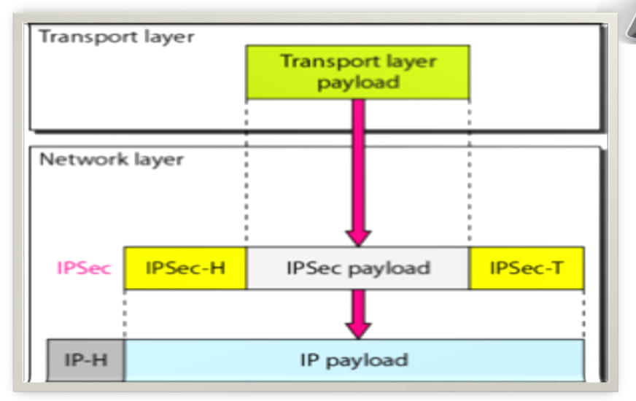
Transport Mode

Slide 35
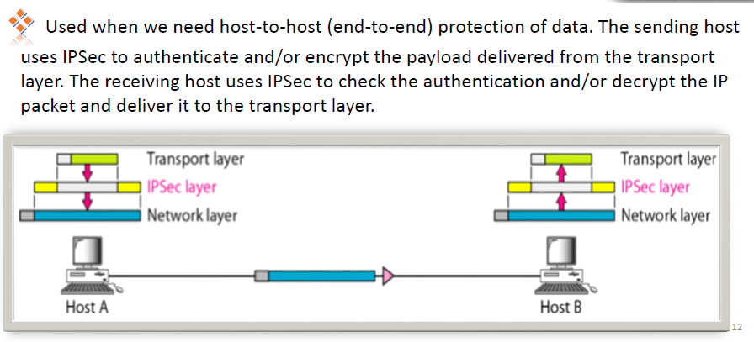
Transport Mode: Usage

Slide 36
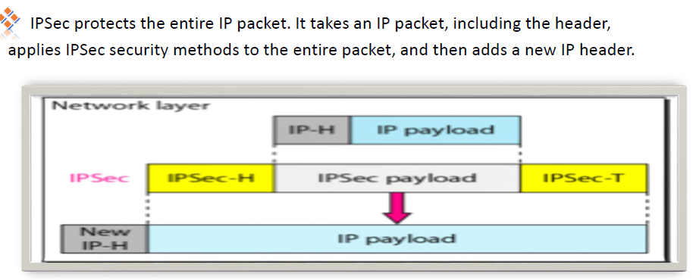
IP Sec: Tunnel Mode

Slide 37
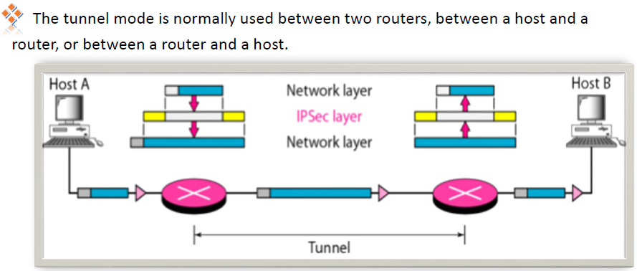
Tunnel Mode: Usage

Slide 38
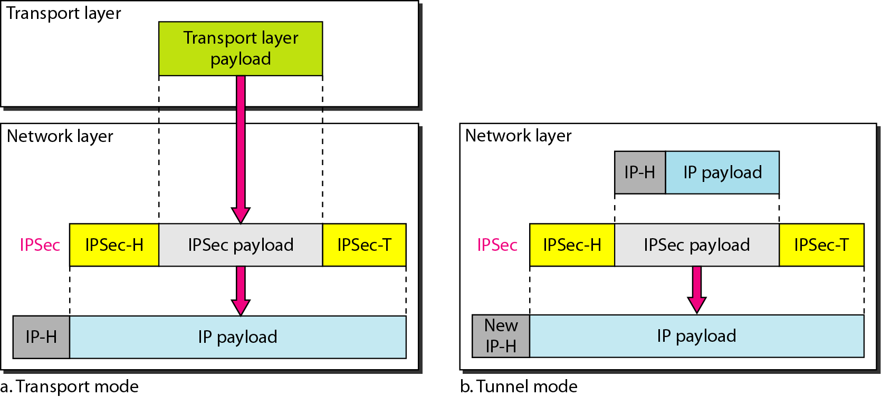
32.<number>

Slide 39
Transport Mode
Host-to-Host
Application Layer
Application Layer
Transport Layer
Transport Layer
IPSec
IPSec
IP Layer
IP Layer
Data Link Layer
Data Link Layer
Host A
Host B

Slide 40
Tunnel Mode
Host-to-Network, Network-to-Network
Application
Layer
Protected
Data
Protected
Data
Application
Layer
Transport
Layer
Transport
Layer
Internet
IP
Layer
IP
Layer
Host A
IPSec
IPSec
Host B
IP Layer
IP Layer
SG
SG
SG = Security Gateway

Slide 41
IPSec Security Protocols
Authentication Header (AH)
Encapsulating Security Payload (ESP)

Slide 42
IPSec Security Protocols
Authentication Header (AH) provides:
- Connectionless integrity
- Data origin authentication
- Protection against replay attacks
Encapsulating Security Payload (ESP) provides:
- Confidentiality (encryption)
- Connectionless integrity
- Data origin authentication
- Protection against reply attacks
Both protocols may be used alone or applied in combination with each other.

Slide 43
Authentication Header
(AH) Protocol is designed to authenticate the source host and to ensure the integrity of the payload carried in the IP packet.
It uses a hash function and a symmetric key to create a message digest; the digest is inserted in the authentication header.
The AH is then placed in the appropriate location based on the mode (transport or tunnel).

Slide 44
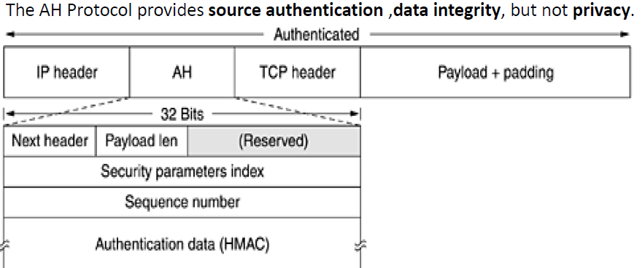
Authentication Header

Slide 45
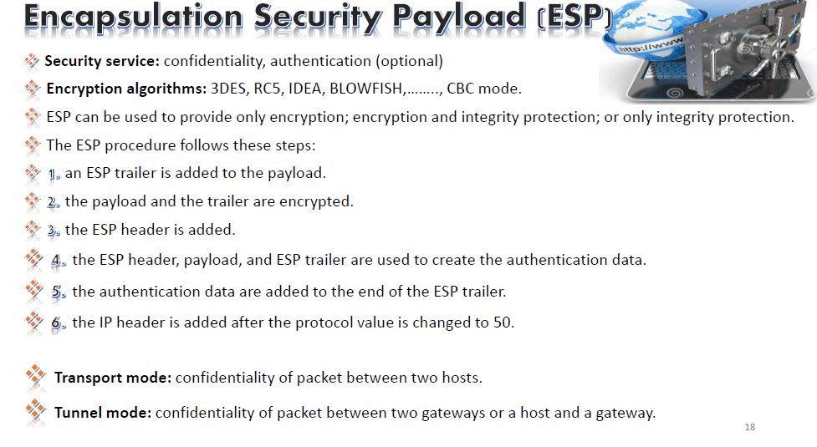


Slide 46
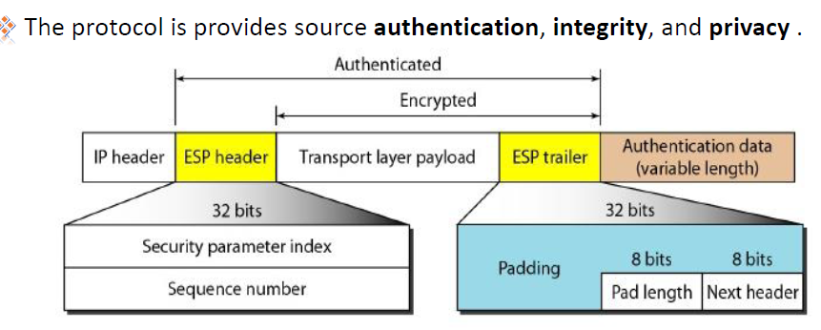
ESP

Slide 47
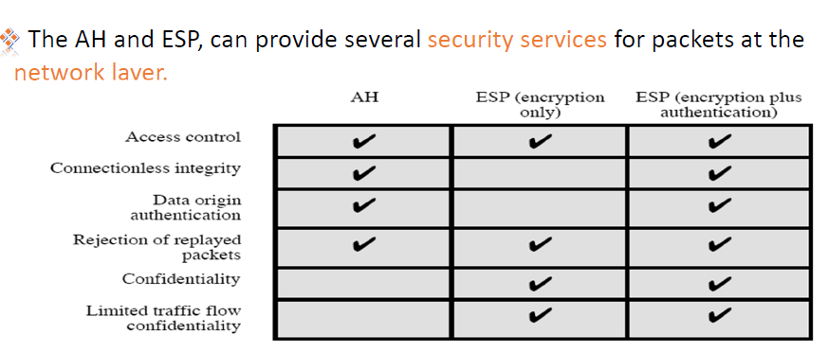
Security Services : AH & ESP

Slide 48
Outbound/Inbound IPSec Processing
The inbound and the outbound IPSec processing are completely independent.
Packet

Slide 49
Outbound IPSec Processing
SPD
IPSec policies
selector
Packet
SAD
SA_{out}
Drop the packet.
Bypass IPSec.
Apply IPSec.
SPD = Security Policy Database
SAD = Security Association Database
SA = Security Association

Slide 50
Inbound IPSec Processing
Packet
Case 1:
If IPSec headers exists
Headers are processed.
SPD is consulted to
determine if the packet
can be admitted based on
the Sa_{in}.
SPD
IPSec policies
SPD = Security Policy Database
SAD = Security Association Database
SA = Security Association

Slide 51
Inbound IPSec Processing
Packet
Case 2:
If IPSec headers are absent
SPD is consulted to
determine the type of
service to afford this packet.
2. If certain traffic is required
to be IPSec protected and its
not it must be dropped.
SPD
IPSec policies
SPD = Security Policy Database
SAD = Security Association Database
SA = Security Association

Slide 52
Security Association: SA
A one-way relationship between sender & receiver.
Specifies IPSec related parameters.
Identified by 3 parameters: Destination IP Address, Security Protocol: AH or ESP, Security Parameters Index (SPI).
There are several other parameters associated with an SA stored in Security Association Database

Slide 53
Typical SA Parameters
Anti-replay related Sequence Number Counter to generate sequence numbers.
Anti-replay window ( something like sliding-window)
AH info: authentication algorithms, keys, key lifetimes, etc.
ESP info: encryption(and authentication) algorithms, keys, key lifetimes, etc.
IPSec mode: Transport or tunnel.

Slide 54
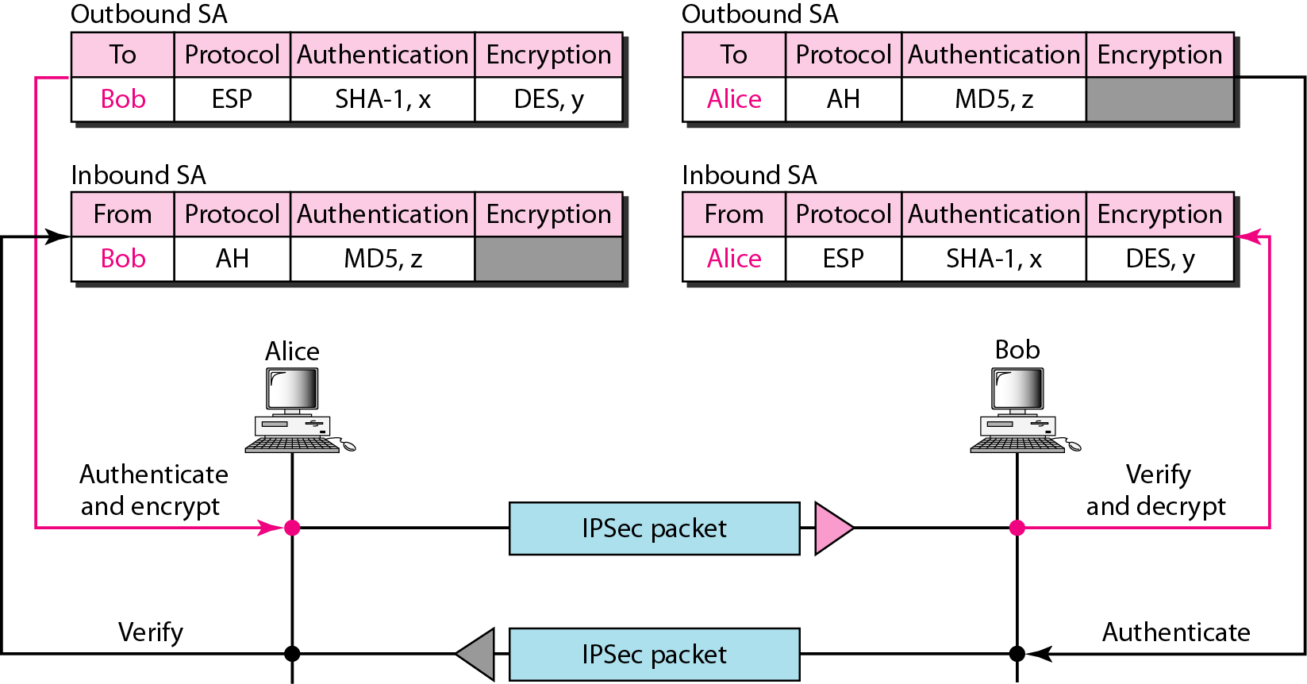

Inbound & Outbound SA

Slide 55
Real World Deployment of IPSec
The Most common use of Ipsec implementations is providing Virtual Private Networking (VPN) services.
Can provide a secure communications mechanism for data and IP information transmitted between networks?
Facilitate the secure transfer of sensitive data across public networks.

Slide 56
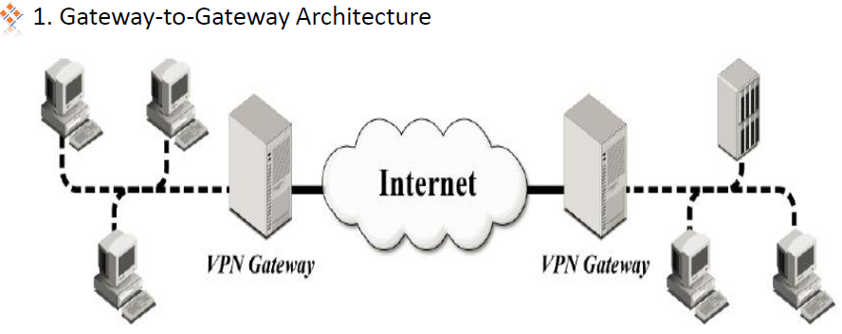
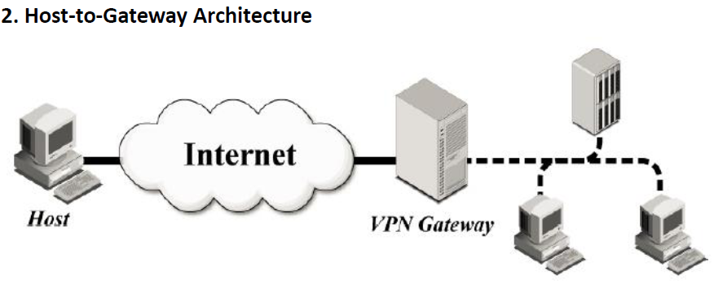
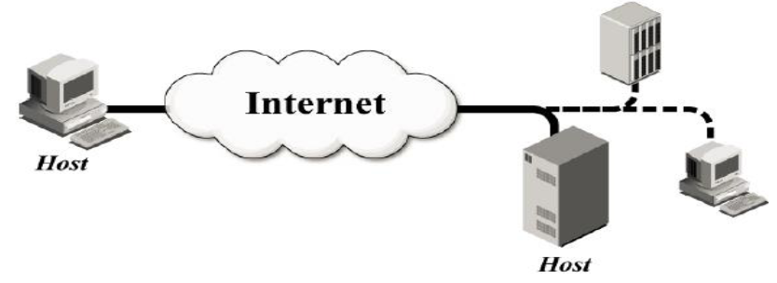

Slide 57
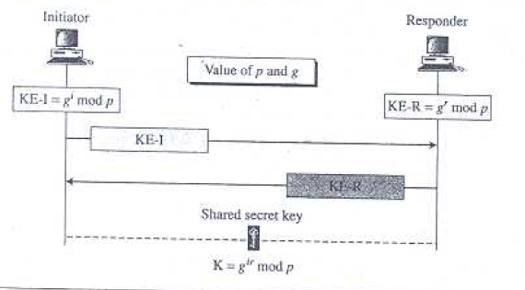
Diffie Hellman Key Exchange

Slide 58
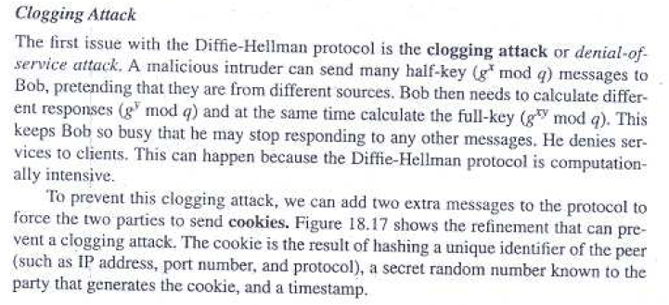
Clogging Attack

Slide 59
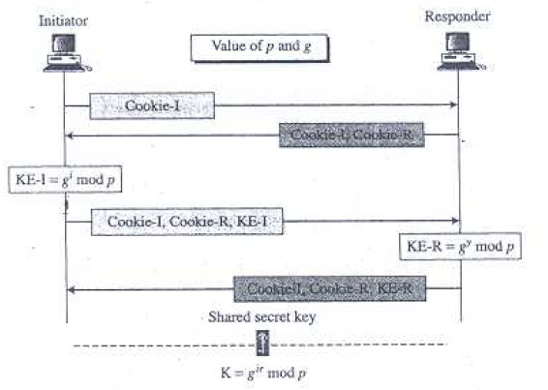
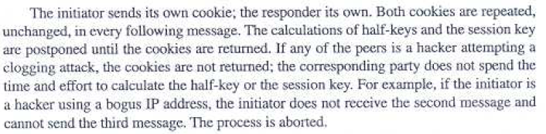
Solution: Clogging Attack

Slide 60
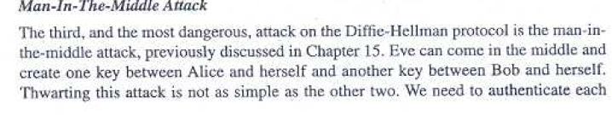
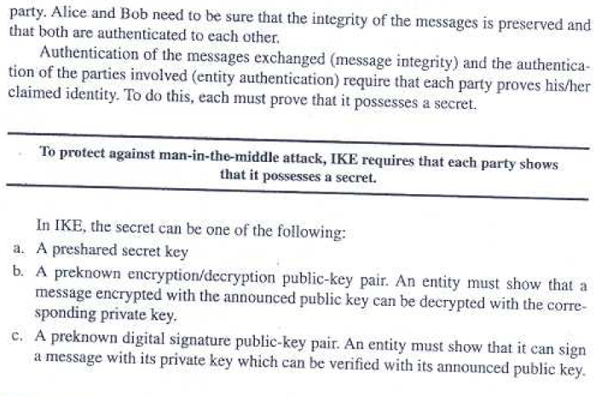

Slide 61
IP Sec: Replay Attack
A replay attack happens when a hacker detects a secure network communication or data transmission, intercepts it, and then retransmits it (or replays it) as if it were their own - in an attempt to trick the recipient.
IPsec anti-replay protects networks against anti-replay attacks by using a sliding window mechanism called anti-replay window. This feature checks the sequence number of each received IPsec packet against the current IPsec packet sequence number range of the sliding window.

Slide 62
Solution: Replay Attack
IPsec uses sequence numbers to identify each packet that belongs to a security association (SA), which is a logical connection between two endpoints that share security parameters.
A sequence number is a 32-bit field in the IPsec header that increments by one for each packet sent.
The sender and the receiver keep track of the sequence numbers to ensure that each packet is received in order and only once.
If a packet arrives with a lower sequence number than expected, it means that it is either a duplicate or a replayed packet, and it is discarded.

Slide 63
Sliding Window Approach
However, sequence numbers alone are not enough to prevent replay attacks, because an attacker could capture and retransmit a large number of packets before the receiver detects the anomaly. To avoid this, IPsec uses anti-replay windows, which are sliding windows that define the range of acceptable sequence numbers for incoming packets. An anti-replay window has a fixed size and a right edge that indicates the highest sequence number received so far. Any packet with a sequence number higher than the right edge is accepted and updates the window.

Slide 64
Conclusion
Strong security that can be applied to all traffic crossing the perimeter.
Traffic within a company or workgroup does not incur the overhead of security-related processing.
IPSec can be transparent to end users.
IPSec is transparent to applications, no need to change software on a user or server system when implementing it in the firewall or router.
IPSec can provide security for individual users if needed.

